Slide 1
St. Francis Programming Analysis
Elaine Codd, Matthew Guevara, Priya Purewal

Slide 2
Agenda
St. Francis Overview
Metrics 2010 vs. 2018
Staff Findings
Patient Findings (Care and Treatment, Grandmothers, MCH, Child Rehabilitation Center)
Testimonials
Takeaways
Core Recommendations
Thank You + Questions
Appendix (Full Feedback, Funding Resources, Case Studies)

Slide 3
St. Francis Overview
St. Francis
Organization Vision: A healthy, socially, and economically empowered community.
Organization Mission: To provide equitable, inclusive, and affordable quality health care, economic empowerment and social services to the community.
Five Strategic Objectives: Economic Empowerment, Family Strengthening, Food Security and Nutrition, Youth Empowerment, Affordable Health Services
Care and Treatment
Originally rooted in the treatment of HIV, St. Francis has expanded to a variety of treatment and health support provided through counselors, an outpatient clinic, and a pharmacy.
Grandmothers
St. Francis provides programming and a community for grandmothers who are responsible for the care and treatment of children impacted by HIV.
MCH
St. Francis provides a variety of MCH care for all mothers, regardless of HIV status. Services include: antenatal, live births, postnatal, and vaccinations.
Child Rehabilitation
The Child Rehabilitation Center aims at rehabilitating HIV Positive or severely malnourished children, reintegrate them into their communities and give them knowledge for a self-sustaining future.

Slide 4
Metrics: 2010 vs. 2018
Metrics | 2010 | 2018
Establish and Support Village savings and Loans Associations (VSLAs) | 11 | 33
Support children through school fees and scholastic materials | 287 | 416
Strengthen follow up of children under the education program through School Visits | 287 | 416
Provide maternal child health services both at the facility and community | 796 | 2,577
Provision of HIV Counseling and testing | 9,984 | 5,293
Conduct routine HTS at ANC, MCH, Immunization to all pregnant and lactating mothers | 304 | 1,516
Retain all newly identified HIV positive persons, pregnant and lactating mothers on ART | 1,151 | 1,933
Diagnose and provide treatment for TB patients | 46 | 34

Slide 5
Staff Findings
What is going well?
Staff Behavior
Committed and Motivated Attitude
Strong Teamwork Skills
Good Relationship with Government on Advocacy
Good Communication within Departments
Program Wins
Diversified Number of Program Offerings
Quality of Service is High
Young Positives Program is a Large Success
Grandmother Market Creation
Demographic Interviewed
Individual Interviews: 12
Length of Time Worked (years): 2-9
Number of Clients Seen per Day: 6-50

Slide 6
Staff Findings
What could be improved?
Recommendations
Staff Support
Unclear Expectations of Roles
Unknown Career Progression / Targeted Professional Development
Staff Shortage / Resource Constraints
Lack of Shared Knowledge
Staff Retention
Patient Support
Lack of Medication Adherence
Better Community Engagement (Within and Between Communities)
Additional Patient / Caretaker Training
Age-Appropriate Activities for Younger Kids
Non-HIV Patient Numbers are Low
Staff Support
Quarterly Town Hall
Role Expectation Definition
Site Visits
Targeted Professional Development Tracks
Increase Part-Time Staff (HIV Adolescents)
Patient Support
Connect Success Stories between Teams
Increased Business and Farming Training for Grandmothers / Mothers / IGAs / Guardians
Toys / Dolls for Children
Specialized Services outside HIV (Dental / Optometrist)
Refreshments / Loudspeaker

Slide 7
Care and Treatment Findings
What is going well?
Medication is Available On-Time
Counselors are Supportive
Confidentiality is Respected
Most Staff has Good Client Handling Skills
Staff Responds to Patient Medication Feedback
Strong Staff Handling of Positive and Negative Couples
Demographic Interviewed
Individual Interviews: 2
Focus Group Size: 6
Length of Time Coming to Visit St. Francis (years): 2-20
How Often Demographic Comes to St. Francis: 1-3 months

Slide 8
Care and Treatment Findings
What could be improved?
Recommendations
Wait Time for Counselors is Long (5-6 Hrs)
No Lunch / Activities During Wait Time
New Staff not as Knowledgeable as 1 yr ago
Community and Patient Discounts for Long-Standing Clientele
Desire for More In-Home Counseling
Desire for Open Feedback Forum
Prescribed Medication is Not Consistently Supplied
ARV Cost Reduction
Lack of Access to Medication across Levels and Costs
Lack of Education on Medication
Lack of Food to Take with Medication
Separation of Stable and Unstable Groups
Provide Entertainment During Wait Times
Young Positives could Perform
Shadowing Program of Experienced Staff
Create a Loyalty Program
Create a Request Form for In-Home Counseling
Create an Anonymous Suggestion Box/Voicemail
Checklist for Staff to Ensure Quality Control
Inventory Tracking System
Payment Plan Options

Slide 9
Grandmother Findings
What is going well?
Grandmothers Love Sense of Community
Workshops and Materials are Appreciated
Primary School Funding is Appreciated
Home Follow-ups are Frequent
Home Construction is Outstanding
Grandmothers are Utilizing Farming Materials
Staff treats Grandmothers Very Well
Grandmothers Love Village Savings and Loans Program
Demographic Interviewed
Individual Interviews: 2
Focus Group Size: 8
Length of Time Coming to Visit St. Francis (years): 12

Slide 10
Grandmother Findings
What could be improved?
Recommendations
Sponsored Children through Secondary School
Need for Pesticides and Medication for Crops and Animals
Increased Training in Business and Entrepreneurship
Lack of market in Jinja
Lack of Research on Quality of Primary Schools
Further Research on Primary Schools
Increased Basic Workshops on Entrepreneurship (with or without materials)
Marketing for the Opening of the Market
Connection / Mentorship / Inspirational Speakers with Guardians and Child Rehabilitation Center

Slide 11
MCH Findings
What is going well?
Strong Customer Care
Medication Arrives on a Timely Basis
Mothers do not Need Services Outside of what St. Francis Provides
Mothers enjoy the Village Saving Program
Day Staff treats Mothers Very Well
Holistic Services Brings Back Hope
Services have helped Raise HIV Negative Children
Demographic Interviewed
Individual Interviews: 3
Focus Group Size: 8
Length of Time Coming to Visit St. Francis (years): 3-4
How Often Demographic Comes to St. Francis: 1-2 months

Slide 12
MCH Findings
What could be improved?
Recommendations
Need for Increased Training
Lack of Mama Kit and Mosquito Nets
Harsh Behavior from Midwives
Night Staff is Inattentive and Sleeping
Lack of Family Planning Options
Lack of Payment Options
Lack of Community Outreach
Lack of Privacy and Confidentiality – HIV Status was Disclosed to Community by Workers
Lack of Premature Birth Expertise
Increased Workshops on Child Care and Rehab, Business and Entrepreneurship, and Village Saving
Midwife and Night Staff Training and Increased Accountability (including Premature Birth Training)
Additional Family Planning Options
Payment Plan
Creation of Private Area
Staff Reminders on Confidentiality Protocols
Separation of HIV Positive and Negative Counseling to Protect Status Privacy

Slide 13
Child Rehabilitation Center Findings
What is going well?
Medication Arrives On-Time and Free of Charge
Child Rehabilitation Center is Paying School Fees
Transport is Being Provided
Child Rehabilitation Center Provides Hope, Positivity and Motivation for Children
Children Enjoy the Development Opportunities in the Peer Education Program
Young Positives Club is Universally Appreciated
Children Enjoy Life Skills Taught
Children Feel Psychologically Supported
Demographic Interviewed
Individual Interviews: 2
Focus Group Size: 8
Length of Time Coming to Visit St. Francis (years): 9
How Often Demographic Comes to St. Francis: Every week

Slide 14
Child Rehabilitation Center Findings
What could be improved?
Recommendations
Fear of Retaliation when Providing Feedback
Public Stigma Prevents Child Adherence
Desire to Attend Friends’ Burial or Memorial Services
Follow-Ups on Reintegrated Children are Infrequent
Lack of Engagement with Other Young Positives Programs
Lack of Diversity of Toys and Recreation
Desire to Share MDD with St. Francis and Community
Desire for Loans to Launch Business Ideas
Desire to Attend Y Plus 3-day Summit
Lack of Holistic Health Education
Anonymous Suggestion Box / Voicemail
St. Francis Memorial Service
Monthly Follow-Ups Paired with Adherence Education for Reintegrated Children
Increased Interaction / Gatherings after Sporting Events with Regional Young Positives
Planned Performances of MDD for St. Francis and Neighboring Community to Advertise St. Francis
Increased Workshops on Finance and Entrepreneurship
Planned Local Business Visit
Skype Interaction with Other Young Positives

Slide 15
Child Rehabilitation Center Testimonials
“Life is precious, and we have St. Francis to thank for that.”
“St. Francis raised my self-esteem, my confidence, and made me into who I am.”
“St. Francis taught me to fight for a stigma-free world.”
“St. Francis is our mother.”
“St. Francis gave me a second chance.”
“I hope that one day I can give St. Francis back everything they gave to me.”
“They have given me education, from nursery all the way until now, and I cannot thank them enough.”
“I’m very proud of the Child Rehabilitation Center and St. Francis; they taught me that I am important. They taught me I want to be something bigger.”
“I owe my life to St. Francis.”
“St. Francis has shown me how children’s lives can be saved.”

Slide 16
Funding Opportunities
Grants
St. Francis’s Services Encompass Several Areas of Donor Interest and Funding: Women’s Empowerment Elder Support & Advocacy Economic Empowerment Youth Programming Health & HIV/AIDS (Resources in Appendix)
IGAs
Expanding IGAs Presents Opportunity to Supplement Operational Budget: Hillcrest AIDS Centre Trust 40% of $1MM USD from Internal Revenue and Craft Store IGAs Case Study (Appendix)
Partnerships & Loans
Fundraising Platforms Solicit Individual Contributions through Donations or Loans: Fundraising Partners Organization Provides Support through Fundraising Process at No Fee to NGOs. Crowdfunding Platforms Self-Initiated Campaigns Fundraising for Organization or Projects. Donations or Loan.

Slide 17
IGA Review
Grandmothers (Farming)
Grandmothers (Crafts)
Child Rehabilitation
Feedback
Useful Workshops
Thankful For Animal & Farming Support
Cannot Afford Medicine for Sick Animals & Plants
Requested More Business Training
Selling Animals at Discount due to Lack Of Access To Market
Recommendations
Shorten Week-long Trainings and Make Them More Frequent
Introduce VSLA Programming for Agriculture Medicine Savings / Pesticide Creation
Feedback
Jaja’s & Staff Thrilled for Craft Store Opening
Want To Create More Crafts if There Was More Opportunity To Sell
Crafts Not High Quality
Difficulty Selling at Main Market
No Access to Markets Outside Of Jinja
Recommendations
Consider Selling in Bulk to Kampala
Online Retail (See Case Studies HACT, Nyaka AIDS In Appendix)
Feedback
Youth Want to Give Back To St. Francis with Time And Resources
Some Guardians Own Land
Youth Desire Opportunity to Support Building Own Business With Loans
Guardian’s Don’t Have Tools or Knowledge Required to Farm
Recommendations
Create Peer Educator Course on External Microloans
Integrate Jaja’s into Guardian Training to Share Knowledge

Slide 18
Takeaways
 | Staff | Care and Treatment | Grandmothers | MCH | Child Rehabilitation
Training / Education | Medium | Medium | Medium | Low | Medium
Community | Medium | Low | High | Low | High
Quality of Care |  | Medium | High | High | High

Slide 19
Core Recommendations
Training / Education
Community
Quality of Care
A Focus on Training:
Bring Grandmothers to speak to Guardians and Young Positives
Implement Shadowing Program for New Staff
Increase Trainings Grandmothers, Mothers, and Child Rehabilitation on Business/Farming
A Focus on Community:
Hold Events after Sporting Gatherings for Young Positives
Host Town Halls and Events between All Staff and Management
Create a Community for Mothers and Care and Treatment
A Focus on Quality:
Maintain Personal Relationships and Follow-Ups with Clientele
Create an Anonymous Suggestion Box
Reduce Wait Times / Create Entertainment During Wait Times
Maintain Confidentiality

Slide 20
Thank You!
To the staff of St. Francis: Thank you for your kindness, openness, and generosity over the past week.
Special Thanks to Ali, Paul, and Mohammed!

Slide 21
Questions?

Slide 22
Appendix

Slide 23
Full List of Staff Positive Feedback
Positive Feedback
St. Francis is using it’s resources effectively to add value to the community. The staff is committed, motivated, and comes to work with the intention to serve. Staff has been known to work despite salary delays. The staff is flexible to work with, and exemplifies great teamwork. St. Francis has a diversified number of program and services. Quality of service at St. Francis is generally high. Staff appreciates the Young Positives program. St. Francis has a good relationship with the government. Viral suppression is going well for adults. Staff enjoy the home visits and feel that they are making a difference. Good communication between staff members within a team. Drugs hare generally well funded. Food security interventions for grandmothers are going well. Grandmothers are responsive to being mobilized. Programming for the grandmothers has led to cohesion within the group. There is a lot of excitement around the Grandmother’s Market construction and kick-off. The savings group available to mother is great.

Slide 24
Full List of Staff Challenges
Challenges
Staff is sometimes confused about what their specific job responsibilities are. Management will randomly add new aspects to staff’s jobs, sometimes without informing the staff. Staff roles and expectations need to be clearly defined. Additional opportunities for career development are being requested, specifically when it comes to skills refreshers and mentorship. Management needs to be more involved in direct service and field visits. By having this experience they can better understand what everyone is doing. There is confusion around the new restructuring. Salaries are sometimes delayed due to funding complications. Employee turnover is high due to low salaries. Transport for both staff and clients is a problem. Not enough St. Francis owned vehicles to effectively conduct work. Staff generally feels that quality of service is more important than the number of people served; could explain lack of data recording. Treatment rates for non-HIV patients are much lower than expected. Specialized services should also be provided at St. Francis (e.g., dental, vision). St. Francis is over-reliant on money from donors.

Slide 25
Full List of Staff Challenges
Challenges
Wants more support from management to treat opportunistic infections. Currently don’t provide comprehensive service and patients feel underserved. Counseling should be done on a weekly basis. Staff wishes they had more time to spend in the clinic serving clients. Some HIV children are depressed and are not being treated for this. Management should bring in other peer organizations who can provide the children with new success stories, and to help the children develop socially. Children need more age-appropriate toys and dolls (specifically for ages 4-7). There is more training required on business practices related specifically to farming. St. Francis staff should provide the farming training and conduct follow up for continuity and increased likelihood of implementation. St. Francis should purchase a loud speaker to use when they are in the field trying to mobilize people for community engagement. Obtain funding for refreshments to provide during community engagement. Schools that St. Francis is providing funds to need to be properly vetted for quality. St. Francis should try to utilize more volunteer healthcare trainees to offset the low number of social workers.

Slide 26
Full List of Staff Challenges
Challenges
Employees are overworked, sometimes working 24 hour shifts. Management doesn’t seem to know what Child Rehabilitation does. Staff roles on IGAs are too confusing; IGAs haven’t had enough time focused to them. Could be helpful to have a specific person assigned to be the IGA coordinator. Guardians are misappropriating funds/resources meant for HIV+ child to their other children. HIV+ children could work part time at St. Francis or at Child Rehabilitation Center to teach them skills and give them opportunity to earn and save their own money. Guardians that have land should farm in order to increase food security. Services to more remote areas is needed. More staff for home-based care is needed. Tools should also be providing for IGAs, not just training. Staff feels constrained by resources; there are instances where the time it takes to get resources could lead to loss of life. Need to reduce the number of part-time employees by replacing them with full-time employees. Staff believes that St. Francis should build a temporary theater until permanent theatre is built. Staff would like their contributions to be formally and regularly recognized. Staff find it hard to find accommodation since St. Francis does not provide it on-site.

Slide 27
Full List of Staff Challenges
Challenges
Constrained by results-based financing since results are not being consistently recorded. St. Francis should have the capability to do blood transfusions. Staff training needs to be targeted and improved. New staff come in with inconsistent levels of experience and expertise. Staff feels that there are no repercussions for bad performance. Need to clearly outline expectations for each role and manage performance. Introduce grandmothers to guardians/caretakers to provide inspiration and support. Staff wants to improve government policies and expand St. Francis’ advocacy work. More training is needed on simple business skills for grandmothers and mothers. Quality of products that grandmothers are producing are not up to par with what can be found in town or online. There are instances where mothers who give birth to an HIV- child later come back with the same child HIV+. Create support groups for mothers/caretakers at St. Francis to foster community. St. Francis farm is missing an irrigation system. Unclear how to operationalize the restructure and strategic plan. Lack of clear succession planning for management, like the Executive Director role.

Slide 28
Full List of Staff Challenges
Challenges
Child medication adherence is a huge issue; lack of food security seems to be a major factor. Follow-up with clients is a problem; clients will disappear and their addresses change. Macro issues hinder progress with clients: stigma, religion, economy. More support wanted for the pediatric clinic; transport cost coverage, pediatric-specific programming to entice caretakers to come to St. Francis. Guardian’s involvement and participation is very low. Relationship between St. Francis between Child Rehabilitation Center is lacking; the organizations don’t effectively communicate and St. Francis is clearly prioritized. Staff is not showing up to weekly Wednesday trainings; staff doesn’t seem motivated to learn when the topic isn’t specific to their role. Culture at St. Francis is to not publicize/promote your work; this must change in order to bring in consistent funding. Staff feels structure is extremely hierarchical and do not feel comfortable interacting with management. Staff would like opportunities to interact with management in a more relaxed setting. For example, a monthly “breakfast/lunch with the director” wherein staff can learn from the director, ask questions, and provide feedback.

Slide 29
Full List of Patient Positive Feedback
Care & Treatment: Positive Feedback
Counselors and social workers are supportive and do a great job of maintaining confidentiality. HIV medications are consistently available when patients come to pick them up. Everyone interviewed has recommended family or friends to St. Francis for services. Majority of staff has good client handling skills. Counselors effectively handled a positive and negative couple. Staff listens and responds to patient medication feedback.
MCH: Positive Feedback
Patient care and service is generally good. HIV medications are consistently available when patients come to pick them up. Patients are generally pleased with variety of services offered. Mothers appreciate the Village Savings & Loans program. Day-staff treats the mothers very well. Thanks to the services provided by St. Francis, mothers feel hopeful especially because some of them have been able to produce HIV- children.

Slide 30
Full List of Patient Positive Feedback
Child Rehabilitation: Positive Feedback
Free medication (HIV-related and other) is greatly appreciated. Transport coverage is excellent and allows them to consistently come to St. Francis. Child Rehabilitation Center coverage of school fees is greatly appreciated; many stated that they wouldn’t be able to succeed without it. The peer education program is great and the leadership opportunity is strongly appreciated. Children enjoy the football programming and the joint programming with other youth positives. St. Francis instills a desire to give back and volunteer. The Young Positives club is a universal success. Testimonies of success stories are very effective. St. Francis provides a platform to share ideas on adherence and how to overcome adherence obstacles. Programming provides a strong education on why adherence is important, it also provides comprehensive education that helps children understand how the HIV virus works and why taking medication is necessary. St. Francis helps them understand why their life is meaningful and why they should adhere. Children love the MDD (music, dance, and drama) club, as well as the Savings Club.

Slide 31
Full List of Patient Positive Feedback
Grandmothers: Positive Feedback
Jajas program is a resounding success. Grandmothers appreciate the sense of community they get from the Jajas program. Constance is much appreciate among the grandmothers. Workshops to train the grandmothers are extremely useful, as well as the materials provided through St. Francis. Primary school funding is appreciated. Grandmothers love when St. Francis conducts home follow-ups. Many grandmothers stated how thankful they were to St. Francis for the construction of their homes. Grandmothers are good about planting on the land that St. Francis bought. Grandmothers are treated very well by staff. Grandmothers are willing to work with/mentor guardians/mothers because they themselves have HIV+ children. The Village and Saving Loans program has permeated through many villages.

Slide 32
Full List of Patient Challenges
Care & Treatment: Challenges
Wait Time for counselors is too long (5-6 hours). No lunch or activities is provided during wait time for counselors. Requested separation between stable and unstable patient groups to reduce overall client wait time. Other facilities give chicken or goats to clients for raising as an IGA. Other facilities give clients bikes, shirts, etc – clients would like St. Francis to do the same. Patients would like more in-home counseling. All staff needs to be properly trained by senior staff; new staff don’t know what to do. Longstanding clients of St. Francis would like community programming (e.g., annual party, community gatherings client discounts) and general respect. These efforts could help to market St. Francis in the community. St. Francis now charges for medication that they used to provide for free. St. Francis prescribes medication they don’t have consistently in stock; causes unnecessary transport costs. St. Francis doesn’t provide food for patients to take their medication. Patients want access to medication of all levels and costs. Patients requested that costs of ARVs be reduced. Patients want more education on how to take meds; new staff just say to take medication but don’t provide additional instruction (e.g., how much food to eat before taking medication). Patients would like St. Francis to gather more consistent feedback from them (e.g., every 6 months). Patients would like to be given discounts and other special treatment for being patients (e.g., discounted medication for their children).

Slide 33
Full List of Patient Challenges
Grandmothers: Challenges
Would like their grandchildren/children to be sponsored through secondary school, as the skills learned in secondary school are more useful for long-term job success. Grandmothers are good about planting crops, but need pesticides and medication to treat animals and crop diseases. Want more business training/workshops for entrepreneurship and businesses. Minimal opportunity in Jinja to sell their crafts; willing to sell crafts in Kampala. Grandmas are short-selling their animals and crops because they are desperate for money.

Slide 34
Full List of Patient Challenges
MCH: Challenges
Continuous training for the Village and Saving Loans program wanted. Mothers would like to be given consistent mentorship and training on: how to raise children, child rehabilitation, business, entrepreneurship. There are not enough midwives/staff to support the number of mothers; wait time for service can be up to 2 hours. Midwives are harsh and not attentive; day staff is great but night staff is problematic (e.g., sleeping, grumpy). Not enough Family Planning options provided; mothers would like a greater variety of options. Mothers would like some sort of mothers community programming. Numerous requests for a Mama Kit to be provided post-birth. Baby mosquito nets are wanted; they are inconsistently given but hospitals always give them. Mothers want payment options; payment plans, health insurance, fixed annual fee charge that could cover treatment and follow up for them and their children. Additional outreach is needed to rural areas. There is a strong desire for a surgical theater, even if temporary. More privacy requested by mothers; would like to have a private room for husbands and HIV+ families to go. HIV+ and HIV- mothers should be split during treatment/drug pick up to protect privacy. Staff needs training on premature births; baby was born after 7 months and midwife took care of them for 6 hours. Baby incubation could be offered at St. Franics; is offered elsewhere. There are two reports of social workers/midwives disclosing HIV statuses to community, breach of confidentiality.

Slide 35
Full List of Patient Challenges
Child Rehabilitation: Challenges
Children want to interact with other Young Positives communities from other regions to learn how they’re coping and living. (e.g. after football matches there should be programming; this helps children share emotions and make friends.) Stigma; parents are seen as sexually promiscuous, or you are sexually promiscuous if you have HIV. More comprehensive health education needs to be provided; more than just medication adherence. Staff does not ask for feedback and there is no platform for feedback to be provided. When children provide bad feedback, they are scared it will get escalated and their medication/services will get cut off; they would like feedback to remain anonymous. Children want a suggestion box for them to provide anonymous feedback. Need more staff who specialize in child/adolescent therapy and treatment. Children want to perform their MDD for the rest of St. Francis. Would like to incorporate a modern influence into MDD. Need to work closer with families of Child Rehabilitation Center; some kids don’t get visits for months. Child Rehabilitation Center families need food provisions so that children can have better medication adherence. More consistent follow ups need to be done with children who have been reintegrated. Bring children back to Child Rehabilitation Center during integration for encouragement and reminders, as children and guardians may need education and reminders on medicine adherence.

Slide 36
Full List of Patient Challenges
Child Rehabilitation: Challenges
Workshops for guardians should be held, so they can learn how to take care of HIV+ kids. Guardians should have a idea sharing and support group community Children want toys, ropes, balls – diversity of recreational activities. Children want to attend the Y Plus Summit through UNYPA with other young positives in Uganda. If children can’t attend, they would like the attendees of the camp to share their experiences with St. Francis. Want more workshops related to entrepreneurship, business, finance, and life skills. Children come up with business proposals but aren’t given the opportunity to launch; children would like a loan from St. Francis that they pay back to start their businesses (e.g., oven for caterer, hair dryer for hair dresser). Children want to attend their friend’s burials or at least have a memorial service at St. Francis. Children want to tour Ugandan businesses to learn about other organizations. St. Francis could help children look for jobs; they want to be able to earn money to pay for food. Children want regular parties/gatherings where they can share stories and photos. Transport costs are seasonal, so children would like a seasonal transport coverage.

Slide 37
Grant Funding Resources
Grants
Women’s Empowerment UN Federal Credit Union (Applications open June 1-30 2019) - https://www.unfcufoundation.org/grants.aspx Women’s Empowerment International - https://womenempowerment.org/ African Women’s Development Fund – http://awdf.org/ Elder Support & Advocacy The Open Society Initiative for Eastern Africa - https://www.osiea.org/grants/ Economic Empowerment Sustain for Life - https://www.sustainforlife.org/grant-making/ Youth Programming Goethe-Zentrum Kampala/ UGCS - https://goethezentrumkampala.org/culture/projectfunding/ Health & HIV/AIDS Mercury Phoenix Trust - www.mercuryphoenixtrust.com US Ambassador’s Special Self-Help (SSH) Program - https://ug.usembassy.gov/embassy/kampala/grant-programs/self-help-grant/

Slide 38
Partnership and Loan Resources
Grants
Fundraising Partners XPO² - https://xpo2.org “We develop innovative concepts and strategies to drive incremental fundraising revenue on behalf of vetted, small- to mid-sized non-governmental organizations (NGOs), charities, and associations located across various cities internationally. XPO²’s digital marketing, fundraising, and e-commerce technologies are free to nonprofits, NGOs, and charities that use our platform.” Crowdfunding Platforms Kiva - https://www.kiva.org/ “Kiva crowdfunds loans and unlocks capital for the underserved, improving the quality and cost of financial services, and addressing the underlying barriers to financial access around the world” GoFundMe - https://www.gofundme.com/ “GoFundMe is a for-profit crowdfunding platform that allows people to raise money for events ranging from life events such as celebrations and graduations to challenging circumstances like accidents and illnesses. From 2010 to 2017, over $5 billion was raised on the platform for over two million individual campaigns and 50 million donors”

Slide 39
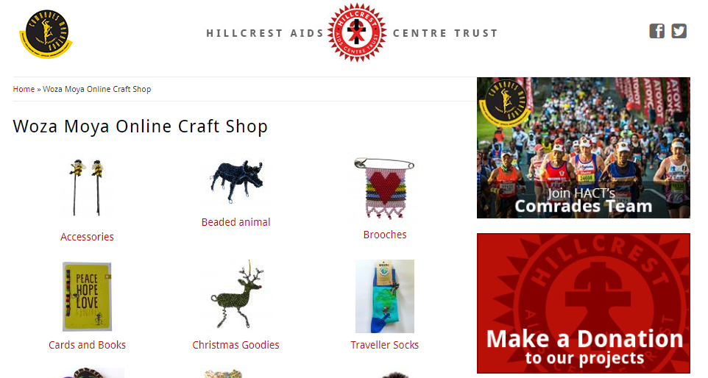
Funding & IGA Case Study: Hillcrest AIDS Center Trust (HACT)
Mission & Programs
HACT is a registered Non-Profit Organization located in Hillcrest, KwaZulu-Natal, South Africa and tackles the HIV/AIDS pandemic by focusing on practical, sustainable and community-led projects and services encompassing; HIV care, HIV prevention and education, community outreach, skills development, and economic empowerment.
HACT runs physical and online craft stores to support unemployed women and organizational funding.
Woza Moya Craft Stores
4 craft stores & online shop, aiming to empower and uplift people infected with and affected by HIV/AIDS to become economically self-sufficient through the production of crafts within their own environment Vision: Teach craft skills to affected individuals through the production and sale of beaded items, ceramics, wirework, crochet work, fabric painting, and sewing Woza Moya provides an income to roughly 300 crafters who are supported by the funds raised through sales

Slide 40
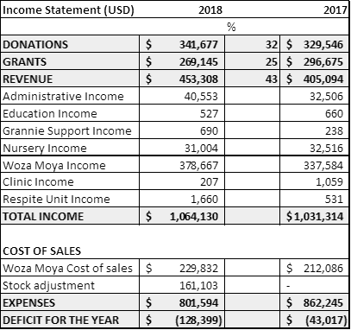
Funding & IGA Case Study: Hillcrest AIDS Center Trust (HACT)
HACT Clothing Scheme
Women sell clothing in their local communities; Over the past year, 751 bags with over 15,000 items have been bought / sold through the Clothing Scheme, generating 300,000 for 36 beneficiaries and their families. Provides local unemployed women with income-generating opportunities as well as skills development training that enables them to financially support themselves and their families through the sale of donated, second-hand clothing.
43% of HACT’s funding comes from internally generated revenue
Links
https://www.hillaids.org.za/
https://www.hillaids.org.za/craft-shop

Slide 41
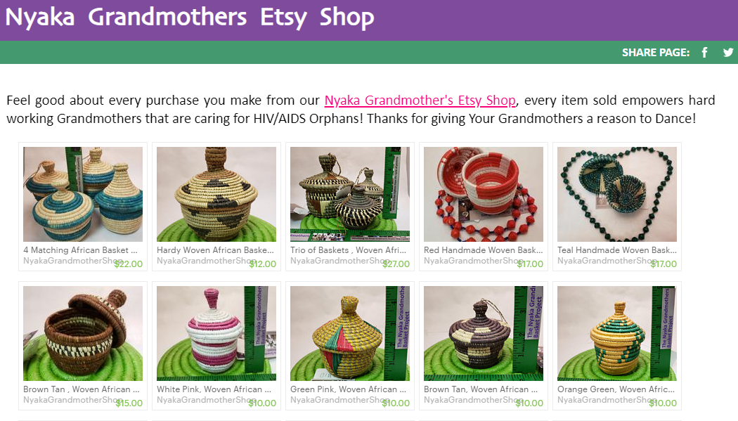
Funding & IGA Case Study: Nyaka AIDS Orphans Project
Mission & Programs
Nyaka educates, empowers, and transforms vulnerable and impoverished communities in Uganda, ensuring that everyone has the chance to learn, grow, and thrive
Nyaka provides orphan education, grandmothers programming, microfinance loans, homebuilding, access to clean water, farming, libraries, and health treatment
Grandmothers Basket Initiative( Etsy Craft Shop)
Grandmothers make beautiful woven baskets, bowls, trivets, hats, purses, paper bead jewelry, and other crafts using natural resources and supplies that they are able to purchase thanks to the microfinance loans that we are able to provide. Nyaka buys the crafts from the grandmothers at a fair price and then sell them through basket parties, our Etsy shop, and in stores. All of the profits raised from the grandmothers’ handiwork go right back to the grandmother programs, which work to empower these hard working grandmothers.

Slide 42
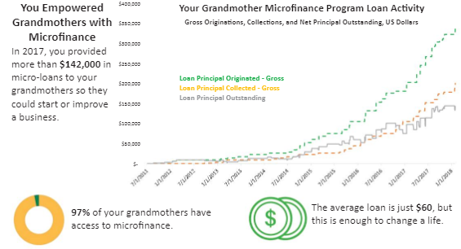
Funding & IGA Case Study: Nyaka AIDS Orphans Project
Microfinance Program
The Microfinance Program provides credit for income-generating activities to women caring for the students of Nyaka and Kutamba. Supplies to make beautiful woven baskets and other crafts Goats and chickens as a source of income
Links
https://www.nyakaschool.org/WIP2/grandmothers/microfinance.htm
https://www.nyakaschool.org/nyaka+grandmothers+etsy+shop.htm

